Slide 1
Unpacking Unconscious Bias
Live Session

Slide 2
Day 2:
All About Bias!

Slide 3
Today’s Objectives
Learn to be more aware of our work environment – to diversity, its components, and our unconscious biases and those of others.
Understand – gain a common understanding of what a respectful and inclusive workplace looks like.

Slide 4
Agenda
Implicit Attitude Test (IAT);
Image activity;
Biases (what they are, where they come from, and who has them);
Biased expressions;
Workplace bias;
The exclusion cycle;
Questions.

Slide 5
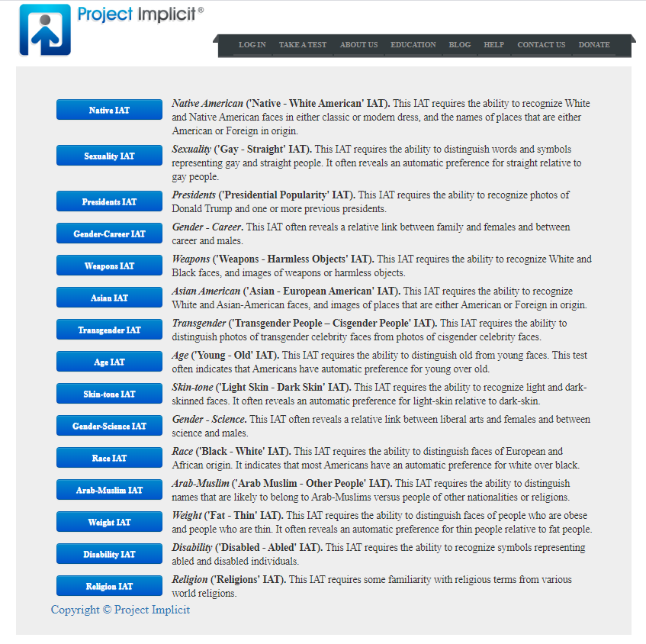
Discussion
Implicit Attitude Test (IAT)

Slide 6
Image Activity
Point of View

Slide 7

Image Activity – Point of View 1
What is your first impression?
Please use one word to describe what you see in this photo.

Slide 8

Image Activity – Point of View 2
What is your first impression?
Please use one word to describe what you see in this photo.

Slide 9
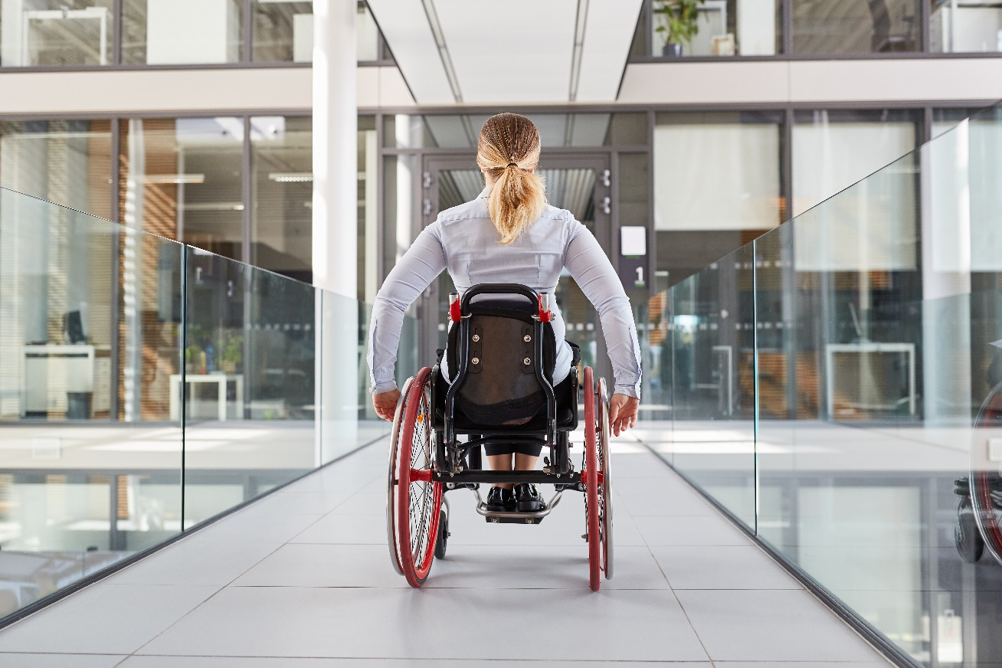
Image Activity – Point of View 3
What is your first impression?
Please use one word to describe what you see in this photo.

Slide 10
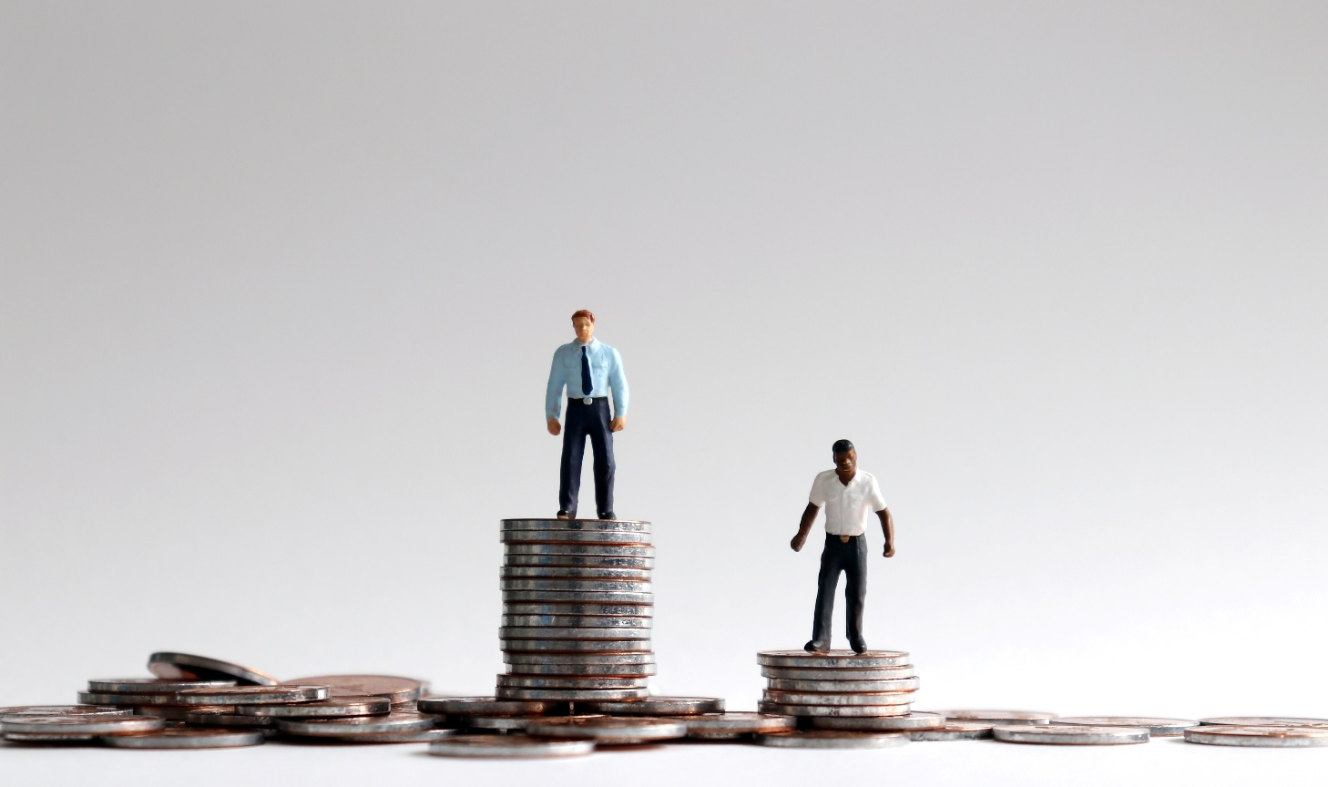
Image Activity – Point of View 4
What is your first impression?
Please use one word to describe what you see in this photo.

Slide 11
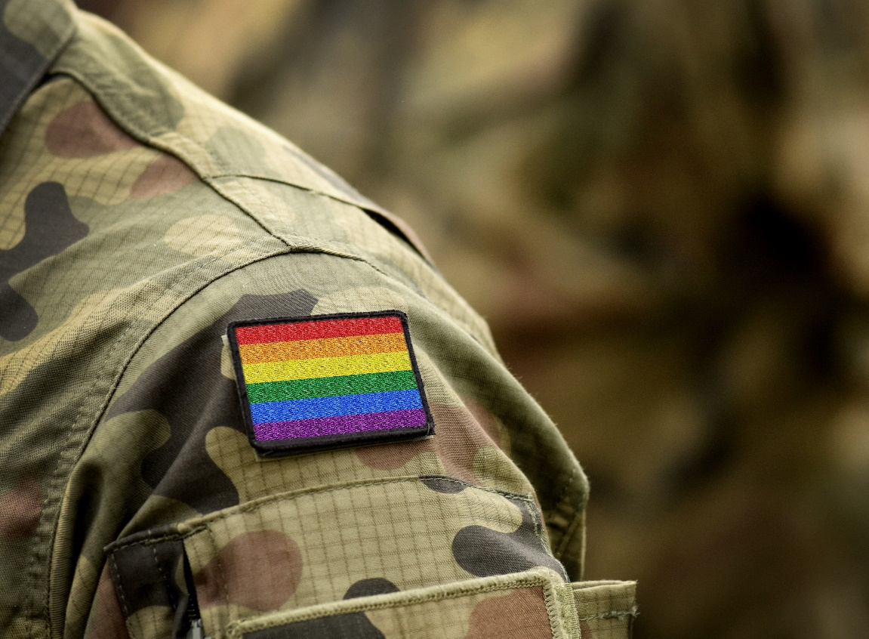
Image Activity – Point of View 5
What is your first impression?
Please use one word to describe what you see in this photo.

Slide 12
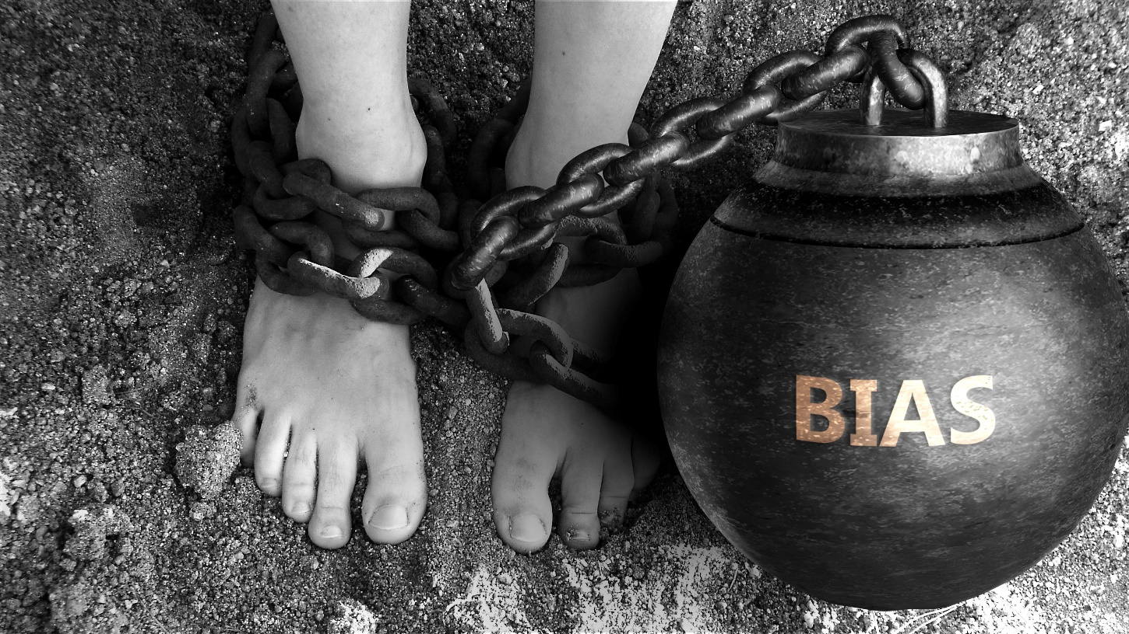
Image Activity – Point of View 6
What is your first impression?
Please use one word to describe what you see in this photo.

Slide 13
What are biases?

Slide 14
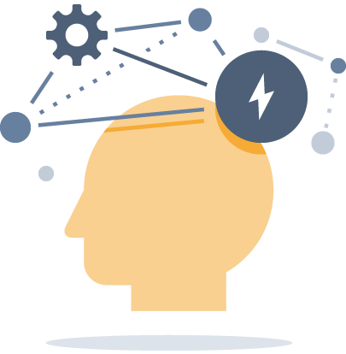
Biases are…
-
Strong attitudes and beliefs, conscious or unconscious, positive or negative, about a particular group of people.
+

Slide 15
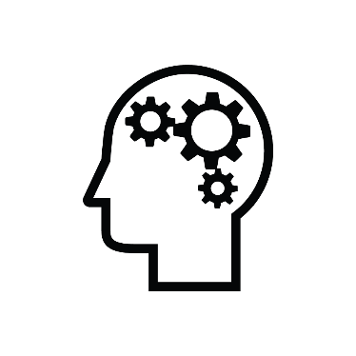
Navigating through the brain
If you are a human, you are biased!
Neuroscience: the brain uses shortcuts/filters to digest information received.
Quick shortcut/filter mechanism: based on our heritage, on our personal background and path!
Shortcuts and filters are based on our “personal baggage”.
Impact of stereotypes, how we categorize people and have a tendency to generalize.

Slide 16
Unconscious Bias Learning Journey
Be aware and self-reflect
Disrupt and mitigate
Understand

Slide 17
Insights from Unconscious Bias Research
Unconscious biases develop at an early age: biases emerge during middle childhood and appear to develop across childhood (Dore, 2014).
Unconscious biases have real world effects on behaviors and attitudes (Dasgupta, 2004).
Unconscious biases are malleable. Each of us can take steps to minimize the impact of unconscious bias (Dasgupta, 2013; Dasgupta & Greenwald, 2013).
Lots of research has been published demonstrating impact of unconscious bias in various domains including hiring/promoting, the criminal justice system, education, and health/health care.

Slide 18
Interesting facts from studies on unconscious bias
“English sounding names” are 47% more likely to get a call back over “foreign sounding names”, in a request for interviews, study conducted in Canada, in 2011, “Why so some employers prefer to interview Matthew, but not Samir?”
Fictitious resumes with “White-sounding names” received 50% more call backs for interviews than “African-American sounding names” (Bertrand & Mullainathan, 2004).
Science faculty rated male applicants for a laboratory manager position as significantly more competent and hireable than female applicants. Faculty also selected a higher starting salary and offered more career mentoring to the male applicant (Moss-Racusin et al, 2012).
Implicit bias among health care professionals can influence their behaviors and judgments (Stone & Moskowitz, 2011).
Since 1997, more than 30 studies have been published relevant to unconscious bias and clinical decision-making. Racial bias is prevalent among healthcare providers and it appears that race influences medical decision making of healthcare providers (Paradies, 2013).
Source: University of California, Office of Diversity and Outreach

Slide 19
Most Popular Biases
Affinity Bias – the tendency to get along with and agree with others who are like us.
Confirmation Bias – the tendency to interpret new evidence or data as re-affirmation of one’s previously existing beliefs.
Conformity Bias – the tendency to behave and act like those around you.

Slide 20
Biased Expressions
What are some examples of stereotypes that you have seen, heard or experiences about certain people?
Culture
Religion
Behaviour
Language
Race
Decisions
Respect
Stereotype
Geography
UNCONSCIOUS BIAS
Prejudice
Ethnicity
Assumptions
Judgement
Sexual Orientation
Preference
Age
Groups
Gender
Unfair
Notes:
“The client might not understand his accent.”
“She has the same management style as me, she should definitely be recommended for the promotion.”
“Millennials are lazier and don't care about work – I think we should hire someone older, they will be more committed to the job.”
“I don't know that we can actually accommodate their disability, and it might actually affect their work quality.”
“I don't have a problem with LGBTQ2+ people, but I feel like they get preferential treatment nowadays.”
“Because this project involves graphic design and web development, I don't think he will be able to keep up, he's kind of older and I don't think he even knows how to use Excel or the Internet.”
“She's from a poor country, so we should show her how to do her work, I want her to succeed.”

Slide 21

Break
Let’s take a quick break.
Please return in 10 minutes.
Please post a green checkmark (✓) when you are back from your break. Thank you!

Slide 22
Break
Please return in 9 minutes.
Please post a green checkmark (✓) when you are back from your break. Thank you!

Slide 23
Break
Please return in 8 minutes.
Please post a green checkmark (✓) when you are back from your break. Thank you!

Slide 24
Break
Please return in 7 minutes.
Please post a green checkmark (✓) when you are back from your break. Thank you!

Slide 25
Break
Please return in 6 minutes.
Please post a green checkmark (✓) when you are back from your break. Thank you!

Slide 26
Break
Please return in 5 minutes.
Please post a green checkmark (✓) when you are back from your break. Thank you!

Slide 27
Break
Please return in 4 minutes.
Please post a green checkmark (✓) when you are back from your break. Thank you!

Slide 28
Break
Please return in 3 minutes.
Please post a green checkmark (✓) when you are back from your break. Thank you!

Slide 29
Break
Please return in 2 minutes.
Please post a green checkmark (✓) when you are back from your break. Thank you!

Slide 30
Break
Please return in 1 minute.
Please post a green checkmark (✓) when you are back from your break. Thank you!

Slide 31
Workplace Bias

Slide 32
Workplace Bias Explained
Attitudes, actions, decisions and results based on irrational thoughts and not facts, which makes them biased.

Slide 33
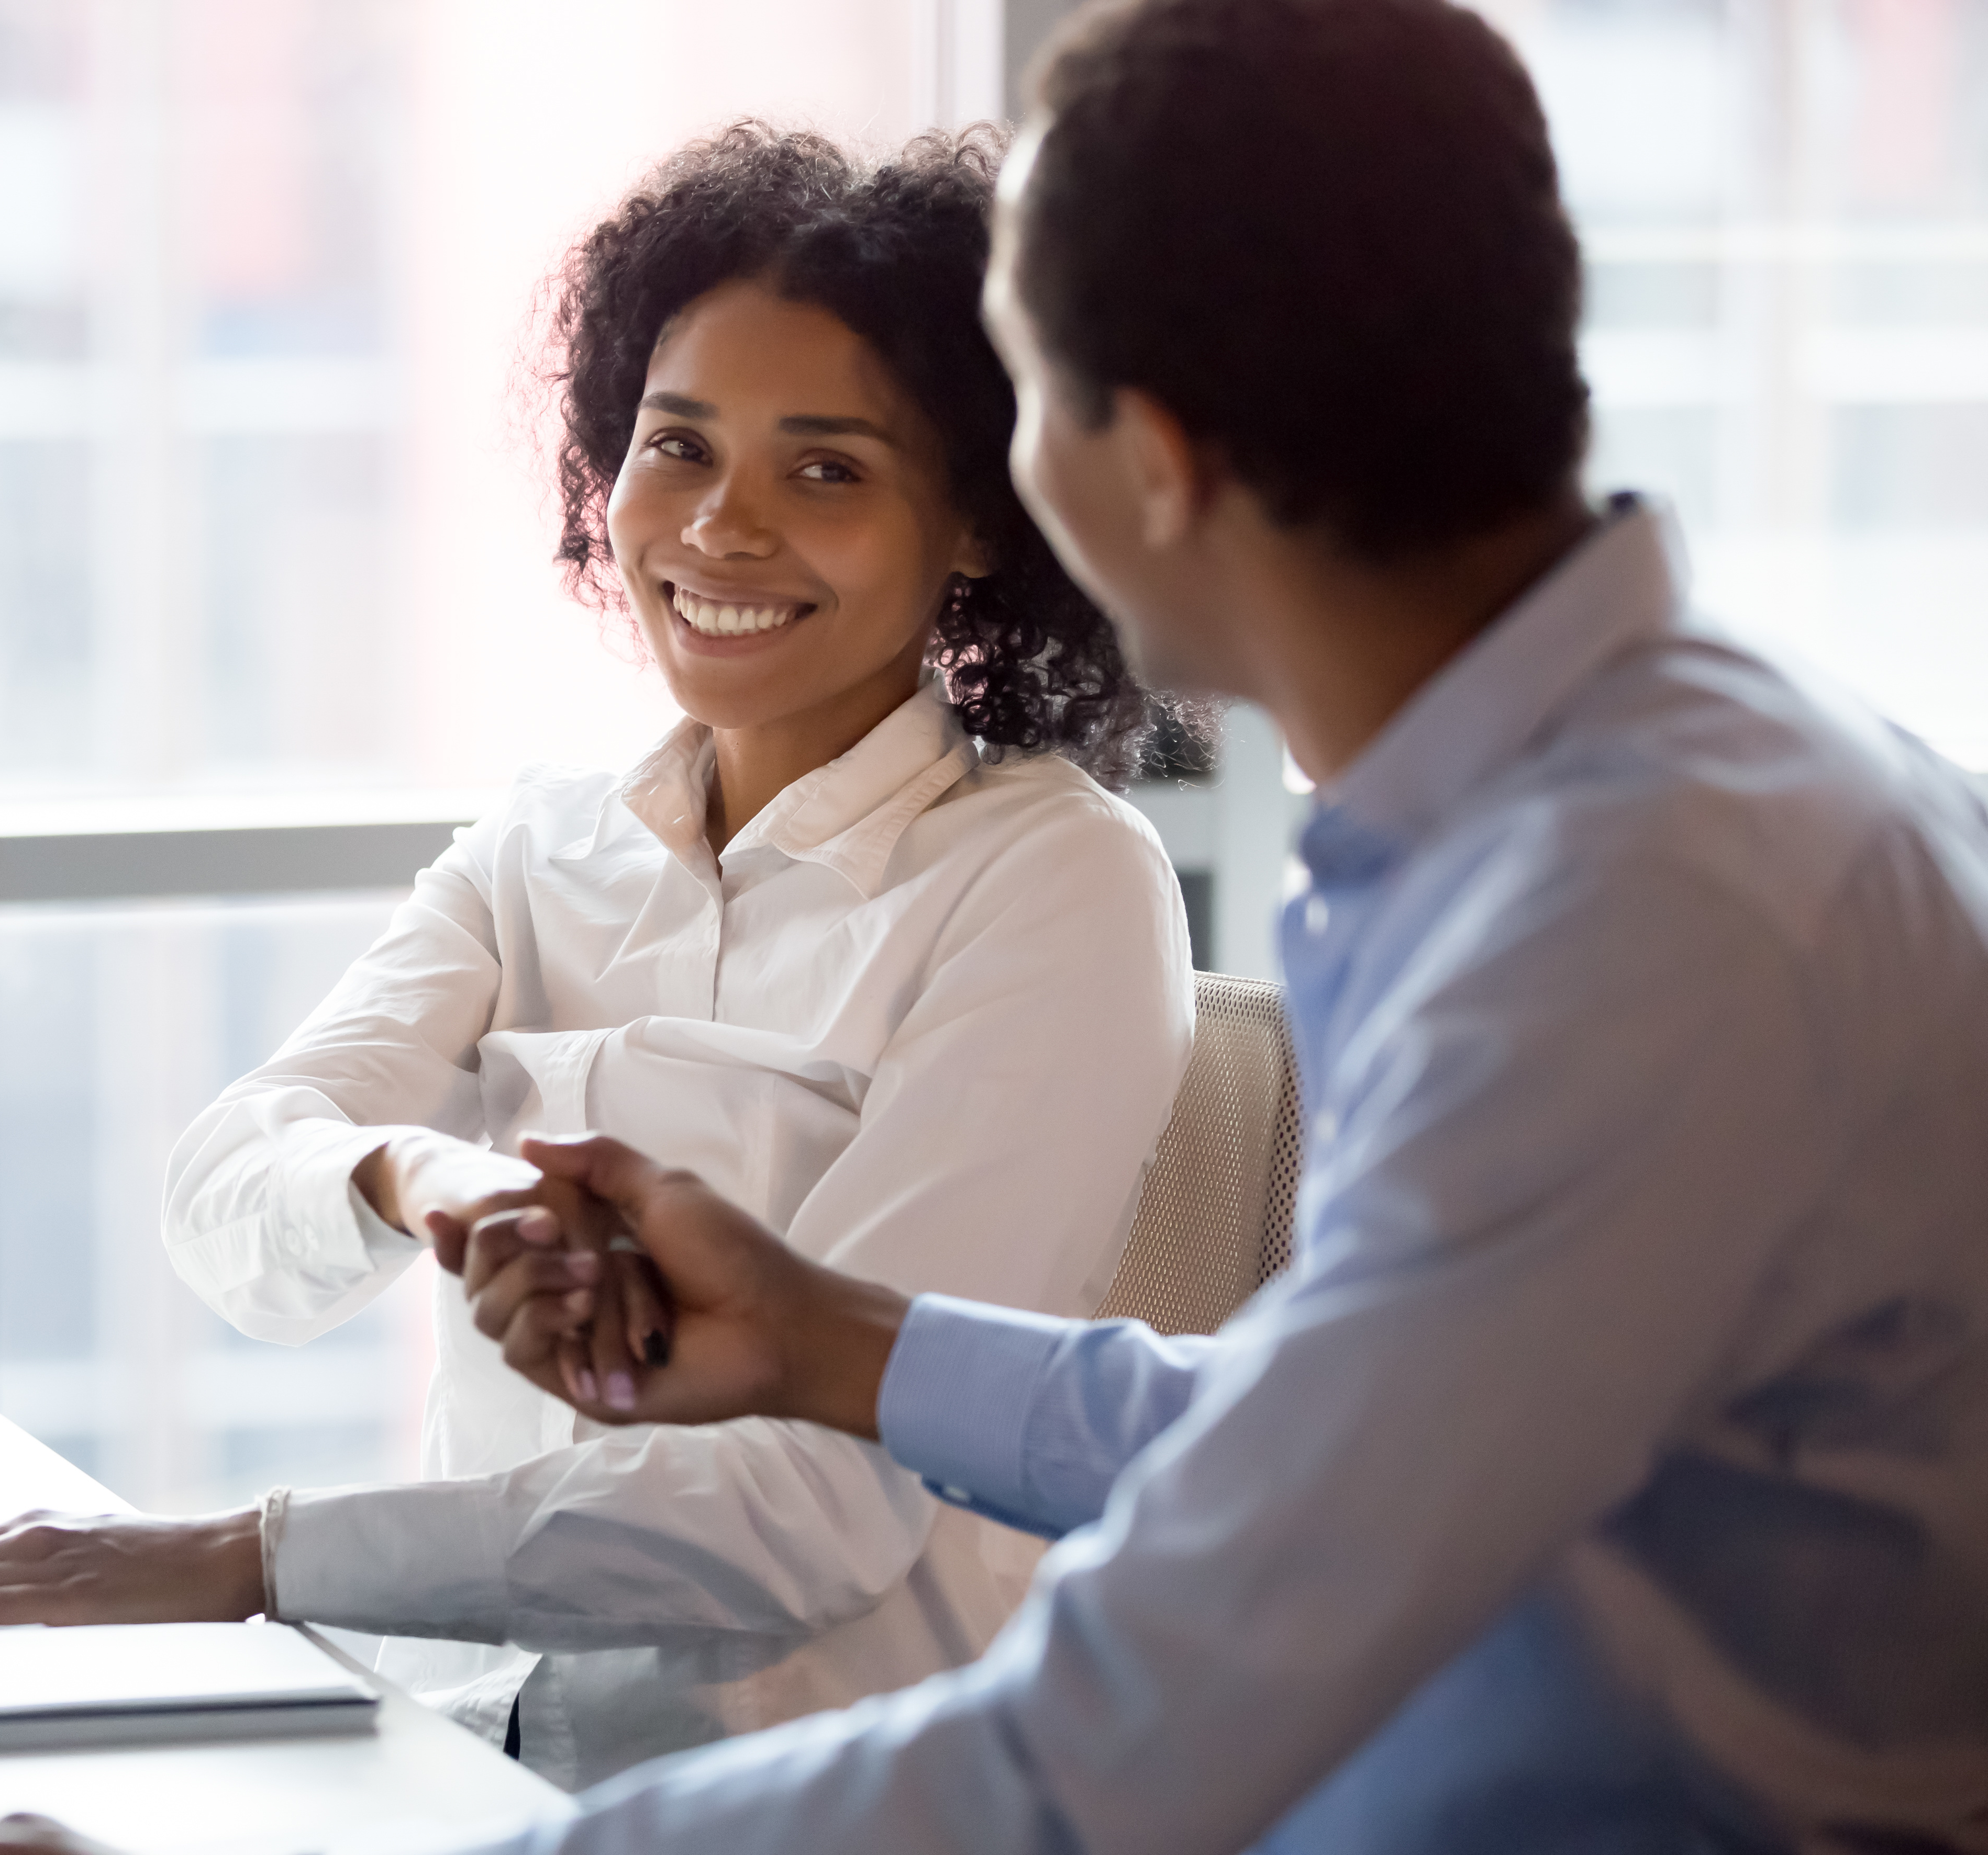
Micro-aggressions
Micro-aggressions: Comments or behaviours that are part of everyday exchanges that send denigrating messages to certain individuals because of their group membership. Brief and commonplace daily verbal, behavioural, and environmental indignities, whether intentional or unintentional, that communicate hostile, derogatory, or negative slights and insults to marginalized individuals and groups.
Examples: Use of sarcasm; denigrating comments; body language such as rolling eyes when someone talks; looking at your watch while someone is talking to you; increased tone of voice, etc.

Slide 34
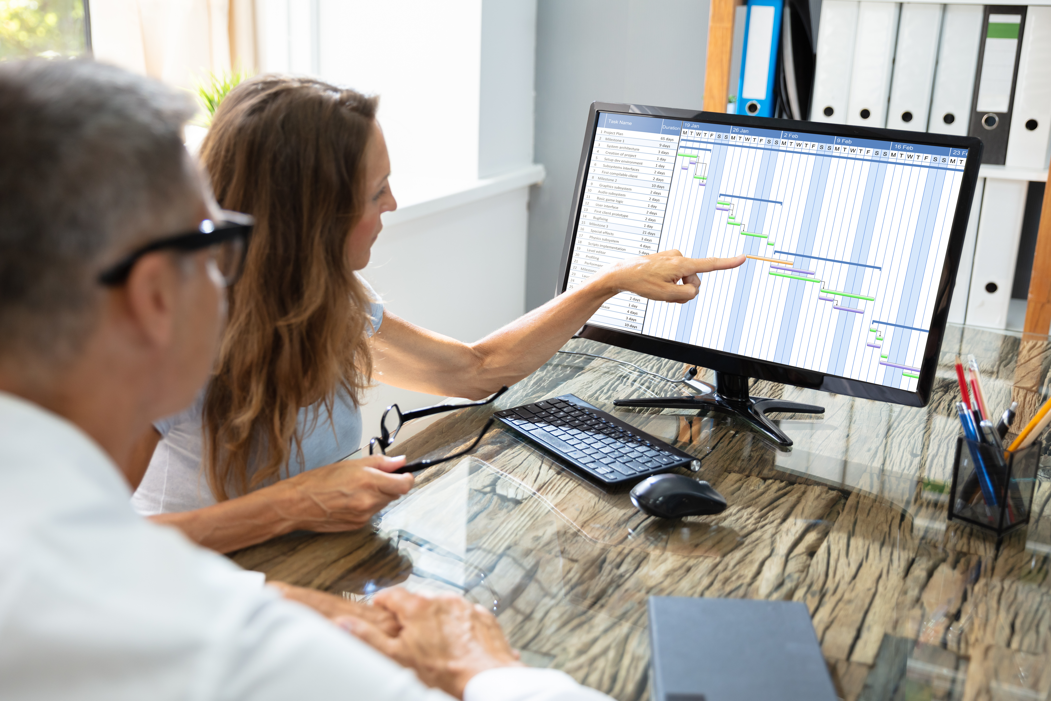
Micro-inequities
Micro-inequities: Subtle, often unconscious, messages that devalue, discourage and impair workplace performance where individuals are overlooked, singled out or ignored.
Examples: Failure of acknowledgement of all employees in meetings or social gathering; not inviting a new employee from a different culture to join the rest of the group at lunch; greeting one employee when they join the group while ignoring others, praising an idea presented by one and ignoring a similar idea presented by another…

Slide 35
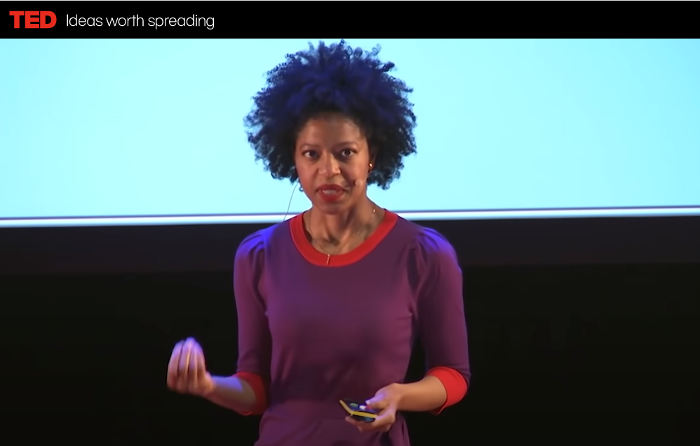
Debrief Video
Eliminating Microaggressions: The Next Level of Inclusion
By Tiffany Alvoid

Slide 36
Biases in Your Workplace
Please answer the following question using the poll function.
Have you or someone you know experienced micro-inequity and/or micro-aggressions in the workplace?

Slide 37
Unpack All The Jargon . . .
Bias, Prejudice, Discrimination, Racism, Exclusion
. . . and break the exclusion cycle
Bias
Prejudice
Discrimination
Exclusion
"They are different"
They are excluded based on biases and stereotypes.
"We are not sure they can do it"
"We won’t consider them"

Slide 38
Questions

Slide 39
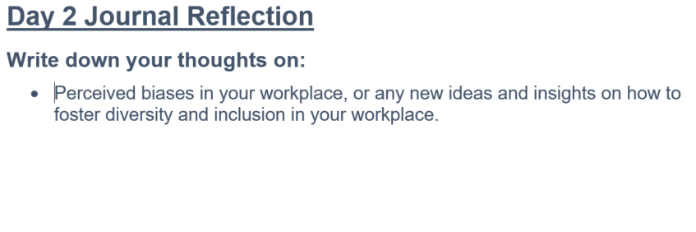
What To Prepare For Next Week
Vocabulary Activity
Video on biases
Personal Learning Journal

